Slide 1
Cloud Computing in Healthcare
Rachelle Azor
Bryan Cabezas
William Dobbins
Jason Sablon
Michael Siegfried
Albertina Webster

Slide 2
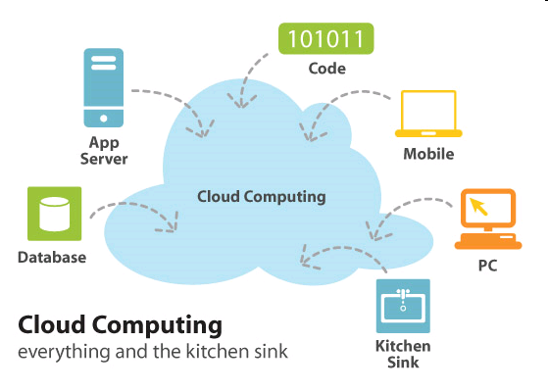
Introduction to Cloud Computing
In order to understand Cloud Computing in the healthcare industry, we must understand the basics of cloud computing in general.

Slide 3
Healthcare & Cloud Computing
Patient’s information would be stored in a cloud
Accessed and managed over the Internet
Since we are on a paperless route, this is a great idea to store information
Authorized users
Information on one cloud is connected to bigger clouds
  Ex. Big Bend RHIO connected to the NHIN

Slide 4
Considerations With Cloud Computing in Healthcare
Since information is stored over the Internet, precautions must be taken
Cloud system must conform to the HIPAA act
  Personal Health Information
  Secure transmission of PHI over the Internet
  Need to maintain a secure, safe, and authorized environment for the prevention of information leakage

Slide 5
Advantages of Cloud Computing
Low costs
  Outsourcing information reduces amount spent on new technology
  Easier to maintain
More secure
  Companies are hired to watch over the information
Interoperability
  Access information from anywhere
  Can be accessed using different devices

Slide 6

Advantages of Cloud Computing
Increases the adoption of EMRs
Beneficial for small companies
Easy to share information among different organizations and doctors

Slide 7
Cloud Computing Disadvantages
Security is the main disadvantage of cloud computing
Consumers are worried about Insurance companies getting a hold of there information and discriminating based upon current medical conditions they may have or medical conditions that they could develop later in life.
They are also worried about government agencies getting a hold of there information and exploiting it to third party vendors, or there place of work.

Slide 8
Disadvantages Cont.
The cloud companies do not always handle all of the security themselves and sometimes pass it off to third party vendors
Consumers need to make sure to thoroughly check out these companies to see who else they are involved with and check out there reputation to see if you trust them to not share your information with any other outside sources. If the third party vendor looks trustworthy then you are probably safe to send your medical records over the cloud safely.

Slide 9
Cloud Computing Costs
Bandwidth
  How much??
Computing Power & Storage
  Outsourced to Server Farms
  Operational Costs
Technical Support
  Server crashes
  Healthcare is time-sensitive industry

Slide 10
Cloud Computing Costs
Necessary Transition
Obama Administrative Policy
  Transform Healthcare thru IT
India & Japan
  Forefront
Canada & China
  Lackadaisical

Slide 11
Future of HIT
Who benefits?
  Physicians, insurance companies
Things made easier
  Software upgrades
  Search engines
More security for the Internet

Slide 12
Cloud Computing Companies
Microsoft
  Windows Azure Web platform
IBM
  EHR’s and healthcare practices
Sun Microsystems
  Write files from browser

Slide 13
Conclusion
What was the healthcare industry like before cloud computing? How has it changed?
What are the goals of cloud computing for the the next 3-7 years?
And Beyond?

Slide 14
Questions

Slide 15
Image Sources
http://lonewolflibrarian.files.wordpress.com/2009/02/cloud-computing-kitchen-sink.jpg
http://www.healthcare-informatics.com/Media/BlogMembers/Social%20media.jpg

